Slide 1
Social-aware Relay Node Selection in Delay Tolerant Networks

Slide 2
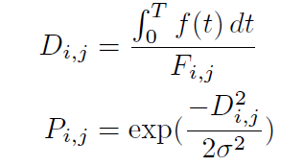





Design Principles
1. Short average path length
Which describes the phenomenon that two people are connected by only a few people
2. Destination-dependent greedy relay node selection
- adopt the connection strength metric
Where :
: Average contact duration
T: Current time
f(t): Binary value表示 在Time t時是否連線
: 指[0,T]時間當中的總連線數

Slide 3
Design Principles(cont.)
3. High cluster coeffictent - Which describes the phenomenon that people are likely to make friends with
his/her friends’ friends.
Thus, even an encountered node is with a relatively low delivery probability but one of its friends has a larger one, we may also forward the message to the encountered one.
e
low deliver probability
other
high deliver probability
other

Slide 4
12/6

Slide 5

TBFS Algorithm
Whenever a new message (eg. e) is generated at a source node,
it is contained following:
hop-to-forward (HoF) value
which value is number of remaining forwarding hops for message e
- will be decreased by one after each forwarding
- the forwarding of message e stops when becomes 0
The initial value of is usually set as 5 or 6
delivery threshold
which will be used to judge whether an encountered node is the best one so far or not - will be updated after each forwarding during the routing process - will be update to the delivery probability of either node or its neighbor (among all of the nodes observed by so far)
The initial value of is the delivery probability of the source node to e’s intended destination

Slide 6
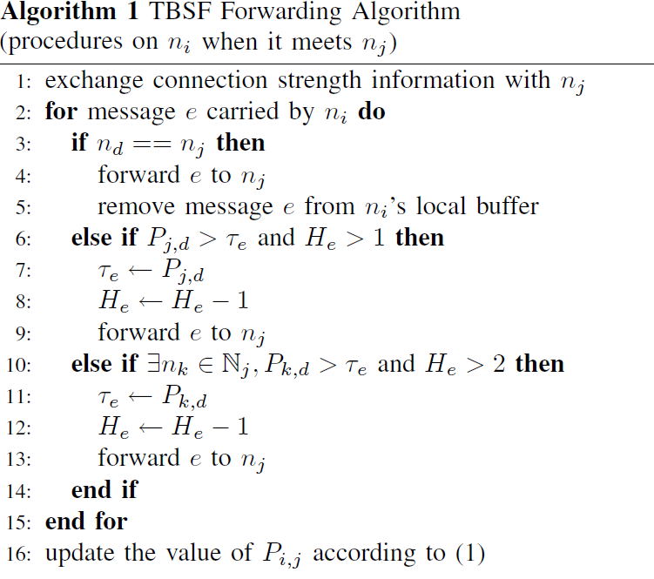

TBFS Algorithm(cont.)
Message e
=5
Message e
The number of remaining forwarding hops
other
=4
other
FinalRecipient

Slide 7

TBFS Algorithm(cont.)
=1
=100
P
=4
=1
Message e
=5
Message e
P
=50
other
=100
=4
P
=20
other
=100
Delivery Probability
Other nodes
FinalRecipient

Slide 8
TBFS Algorithm(cont.)
=100
=30
=50
Message e
Message e
=2
=3
=1
=30
P
=100
=70
other
=1
=2
Message e
=30
=100
other
=1
Message e
Other nodes
=100
FinalRecipient

Slide 9
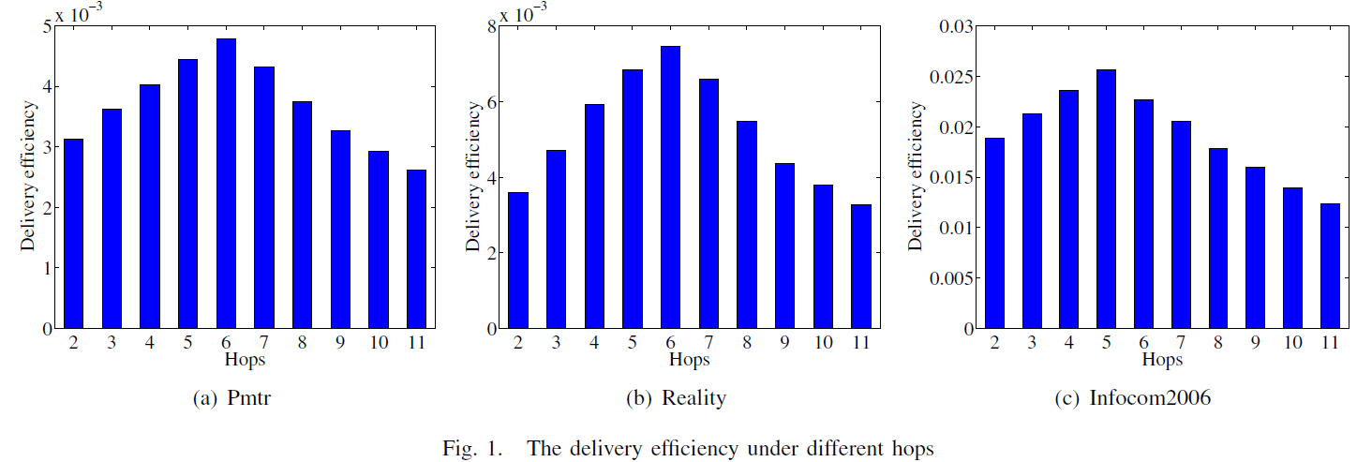
Delivery efficiency
The efficiency is quantified as the ratio between the delivery ratio and the delivery cost
The maximum forwarding hops when the initial value of HoF is small(0~4),shows as an increasing function,because only few messages are successfully delivered,which even implies low delivery cost.
With the increasing of Hops until 5 or 6,although the delivery cost increases,but the delivery ratio increases faster than the cost and thus improves the delivery efficiency.
After the peak value,further increasing hops will incurs unnecessary forwardings,contrarily degrades the delivery efficiency.

